Slide 1

Glance 2.0
ICG | Rates
Summer Analyst Presentation | 7/22/18
Summer Analyst – Rates
Mandy Hsu, Vincent Taylor, Tahiya Chowdhury
July 23rd, 2018
Strictly Private and Confidential

Slide 2
Agenda
About Us
Our Assignment
Snapshots
Our Technology
Challenges/Solutions
Impact
Q/A

Slide 3
1. About Us

Slide 4
Rates – ICG Technology
Our Team
Mentors/Buddies
Sam Eberspacher
Vincent Taylor
Moshe Teitz
Mandy Hsu
Tenzing Passang
Tahiya Chowdhury
Rates Technology
Managers
Phillip Jung
Jonathan Elphick

Slide 5
Rates Technology
Deals within the G10 market
Exclusive for e trading
Develops important internal software such as the pricing tool for various bonds

Slide 6
2. Common Slides
2. Our Assignment

Slide 7
Rates – ICG Technology
Glance
How it worked
Primary Functions
Monitoring existing tools’ health status that are internal to rates
Participating Members
Glance
Tasks
MKV Fetch
Tasks
Web Server
Tasks
Glance 2.0
Our Changes
Primary Functions
Monitoring existing tools’ health status that are internal to rates
Participating Members
Glance 2.0
Ignite Cluster
Tasks
Web Server
Tasks

Slide 8
3. Snapshots

Slide 9
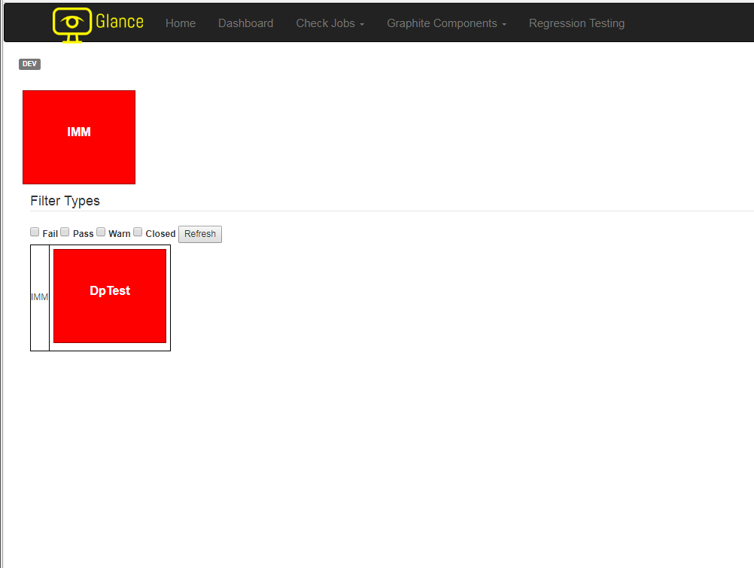
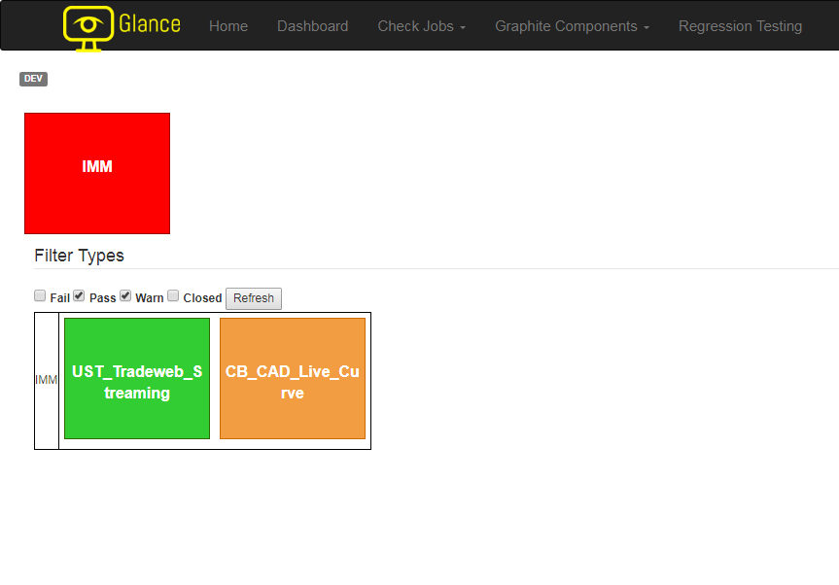
Glance Snapshots
Home page of Glance 2.0: Filters the nodes by their status and displaying those failing by default for immediate attention
3
Text and Layouts

Slide 10
Glance Snapshots
3
Text and Layouts

Slide 11
Ignite Snapshots
3
Text and Layouts

Slide 12
Running Checks (Glance Ignite Communication)

Slide 13
Running Checks (Glance Ignite Communication)

Slide 14
4. Our Technology

Slide 15









Technology Stack
4

Slide 16
5. Challenges/Solutions

Slide 17
Challenges and Solutions
Software installation: CMP requests delay project work
Solution: Constant communication with mentors and help desks to expedite the process
Maintaining development standards while adding new features
Solution: working with the experts in the team and regular scrums amongst ourselves
New software, tools, programming languages
Solution: mentorship from team, external documentations

Slide 18
6. Impact

Slide 19
Impact
Usability
Incorporation of SQL syntax for simplicity
Immediate reach to critical data
Performance
Ignite increased our backend capacity
Made scaling easier
Rearrangement of the user interface to minimize response time

Slide 20
Questions?

Slide 21
References/Sources
https://ignite.apache.org/

